Slide 1

Hotel Management System
Helina Ahmed
Naveen Kumar Janarthanam
Rafia Sharmin Alice
Rishav Gautam
Supriti Ghosh
CSC- 785-Information Retrieval & Storage
Department of Computer Science
University of South Dakota

Slide 2
Cardinality
books
Customer
Room
orders
Customer
Food
receives
Customer
Services
provides
HR
Services

Slide 3
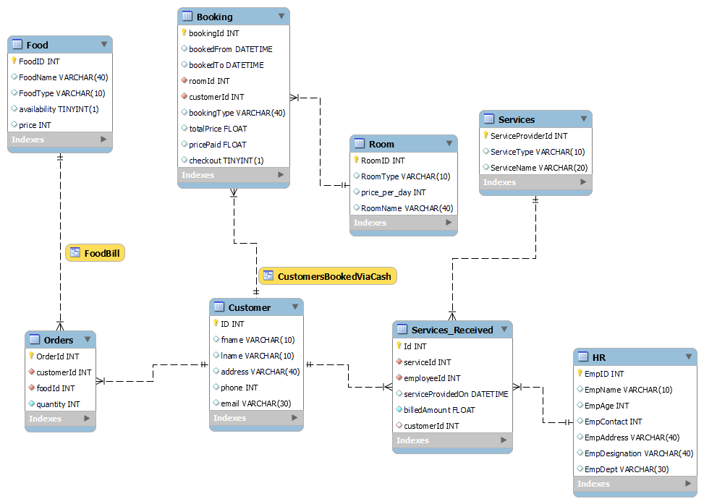
ER Diagram

Slide 4
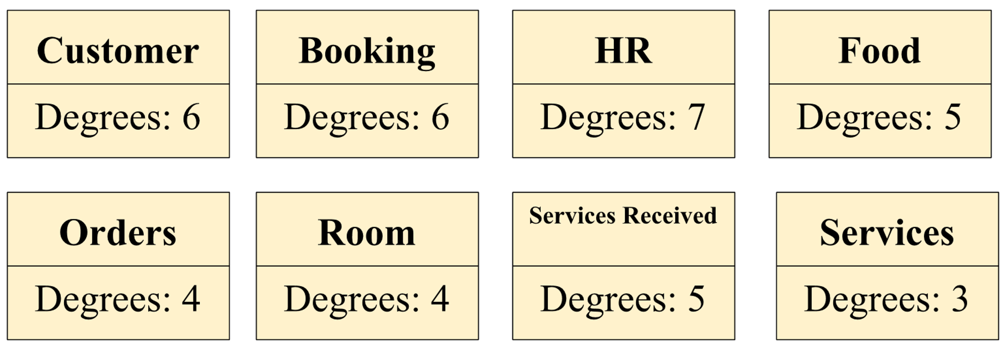
Degrees

Slide 5
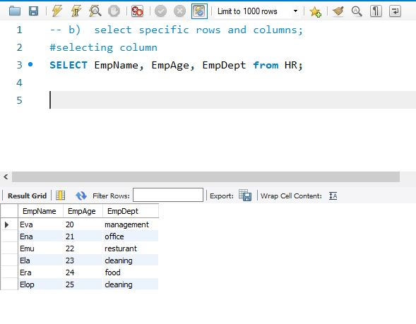
Selecting rows and columns

Slide 6
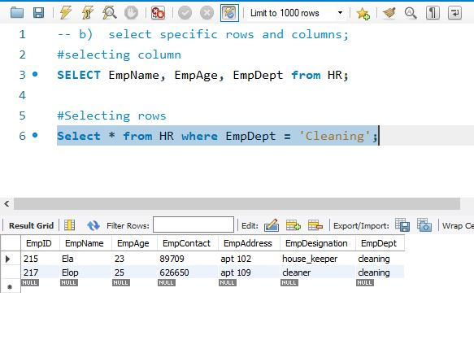
Selecting rows and columns (continue)

Slide 7
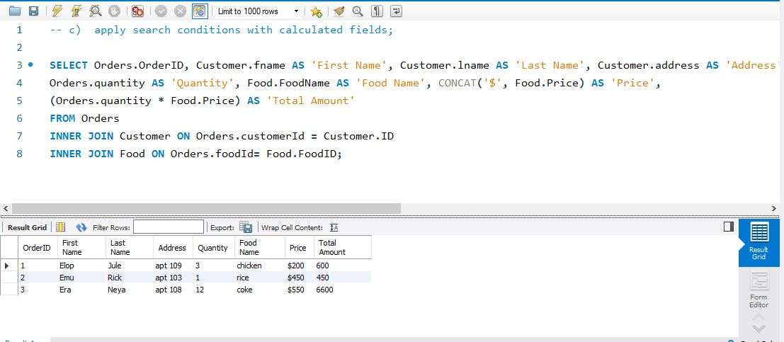
Applying search conditions with calculated fields

Slide 8
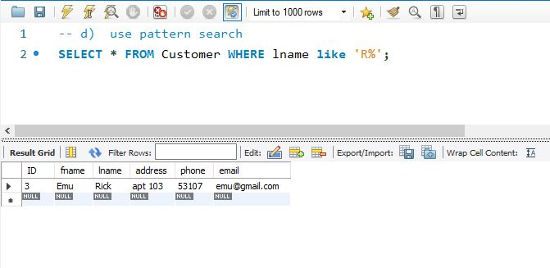
Using pattern search

Slide 9
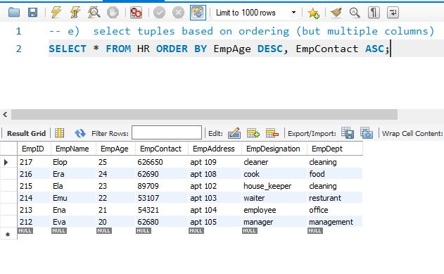
Selecting tuples based on ordering

Slide 10
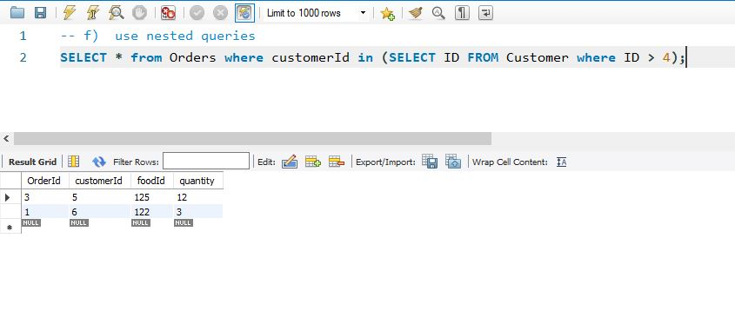
Using nested queries

Slide 11
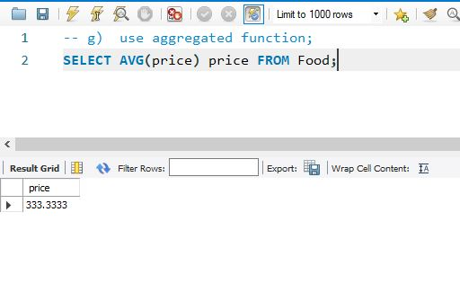
Using aggregated function

Slide 12
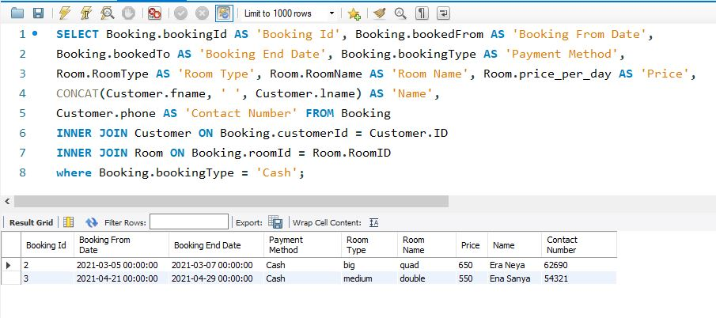
Multiple Relations in a query

Slide 13
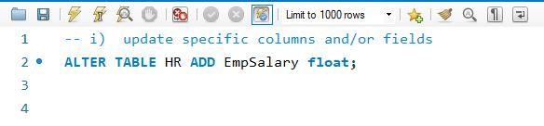
Updating specific columns and fields

Slide 14
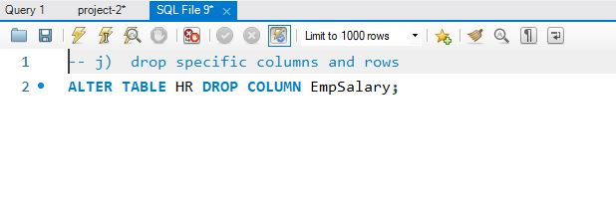
Dropping columns and rows

Slide 15
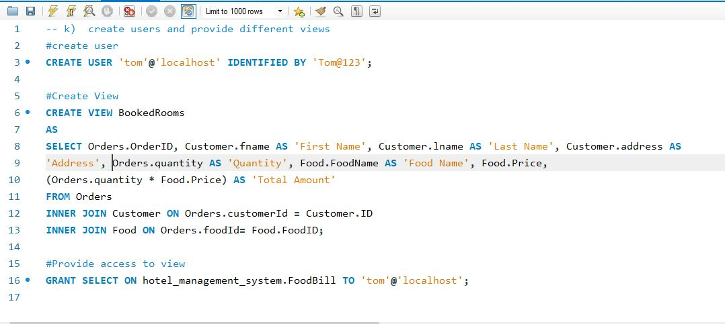
Creating users and providing different views

Slide 16
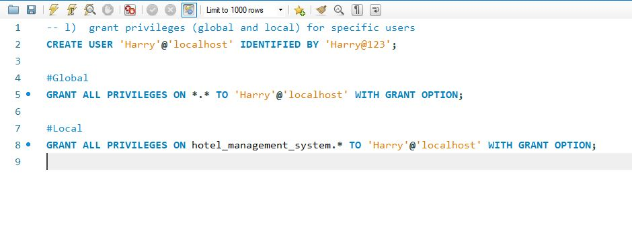
Grant Privileges (global and local) for specific users

Slide 17
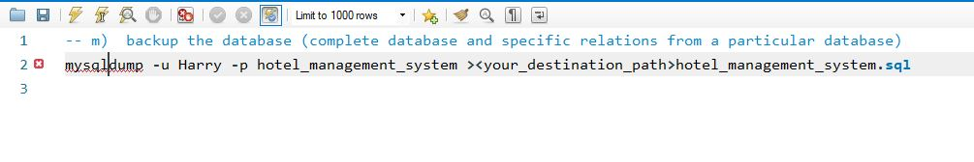
Backup the Database

Slide 18
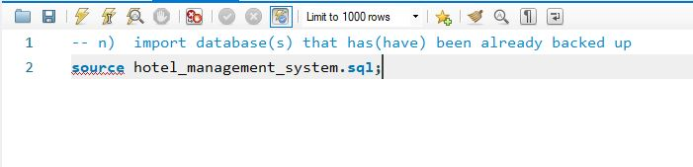
Importing the Database

Slide 19
Demo

Slide 20
Thank you

